Slide 1
Covid-19 and language education: Two challenges, one response
David Little
Trinity College Dublin

Slide 2
Even with the development of vaccines, no one knows when the world will find a solution to the Covid-19 problem
No one knows if we shall ever return to what we thought of as normal life
It is not too soon to confront the educational challenges Covid-19 has brought and search for effective responses
The purpose of this webinar: to outline a single, integrated response to two challenges Covid-19 has brought to language education:
Public examinations
Distance learning

Slide 3
The two challenges
1. Public examinations
Widespread cancellation of public exams has thrown education systems into chaos
Algorithms are no substitute for student performance – and the very fact that they are used raises awkward questions of validity and reliability
In most education systems teacher grades for language exams cannot be translated into a summary description of students’ proficiency
When reliance on teacher grades leads to “grade inflation”, this is the fault of the system, not of teachers
2. Distance learning
Effective distance learning requires much more than a reliable laptop, a stable internet connection and a quiet room
To what extent are students capable of being autonomous learners?
How effectively do we help them to develop skills of self-management?
Are we providing them with appropriate tools?
As they manage their own learning, how effectively are they able to monitor their own progress in relation to curriculum goals?

Slide 4
The CEFR/CEFR-CV to the rescue
Policy
The CEFR/CEFR-CV’s illustrative scales allow us to bring curriculum, teaching/ learning and assessment into closer alignment with one another than is usually the case
Each “can do” statement can be used simultaneously to
specify a learning outcome
provide a learning focus
imply an assessment task
Because “can do” descriptors focus on behaviour, learners themselves can participate in the new assessment culture that these considerations imply
Practice
All Council of Europe education projects aim to help develop the individual citizen’s ability to participate, critically and proactively, in the democratic process
The Council of Europe first introduced the concept of learner autonomy to language education (Holec 1979)
The language user/learner described by the CEFR/CEFR-CV is autonomous by definition
a social agent who has tasks to perform (cf. CEFR 2001: 9
“can do” is the basis of self-management
The European Language Portfolio was conceived as (among other things) a means of fostering learner autonomy

Slide 5
The European Language Portfolio
Purpose
To mediate the ethos of the CEFR and the values of the Council of Europe to language user/learners
To encourage and support
Learner autonomy
Intercultural awareness and intercultural learning
Plurilingualism
To familiarize language user/learners with the CEFR’s action-oriented definition of language proficiency
Learners use checklists of “I can” descriptors to identify learning targets and evaluate learning outcomes
Goal-setting and self-assessment are the bedrock of reflective, autonomous learning
A brief history
1997: The concept of the ELP introduced along with the second draft of the CEFR at an intergovernmental conference
1998–2000: Pilot projects carried out in 15 Council of Europe member states and by four INGOs
2000–2009: ELP design and implementation supported by a series of eight European seminars
2000–2010: 118 ELPs from 33 member states and six INGOs validated and accredited by the ELP Validation Committee
2011–2014: 23 further ELPs registered by the Council of Europe

Slide 6
The European Language Portfolio
Obstacles to widespread use
ELP development was rarely part of a larger reform of curricula and assessment
There was often a mismatch between curriculum goals and “I can” descriptors
Official support for ELP implementation rarely continued after pilot projects
The ELP’s focus on learner autonomy was often in conflict with dominant teaching methods
ELP models were often too “heavy”, which brought them into conflict with textbooks
Self-assessment, on which successful ELP use depends, was alien to most national education systems and teachers
And yet …
The pedagogical ambitions of the the CEFR Companion Volume require a renewed focus on the three goals of the ELP:
Learner autonomy
Intercultural awareness and intercultural learning
Plurilingualism
Most national curricula include critical thinking and learner autonomy among their key objectives
Universities routinely claim to develop their students’ capacity for critical thinking
The goals and spirit of the ELP should play a central role in our response to the challenges of Covid-19

Slide 7
So how do we respond to the twin challenges that Covid-19 poses?
At the level of policy

Slide 8
So how do we respond to the twin challenges that Covid-19 poses?
At the level of policy
State or restate communicative curriculum goals in “can do” terms; summarize as a learner profile

Slide 9
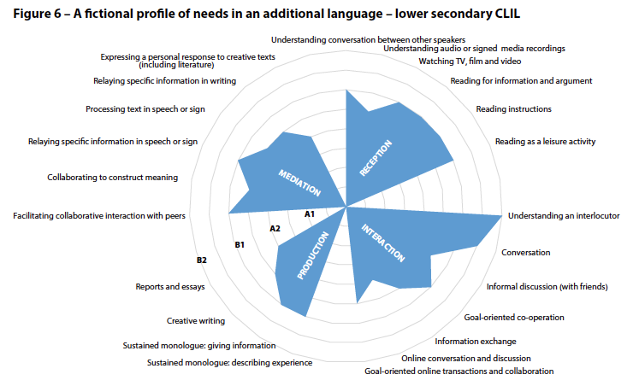
CEFR-CV, p. 38

Slide 10
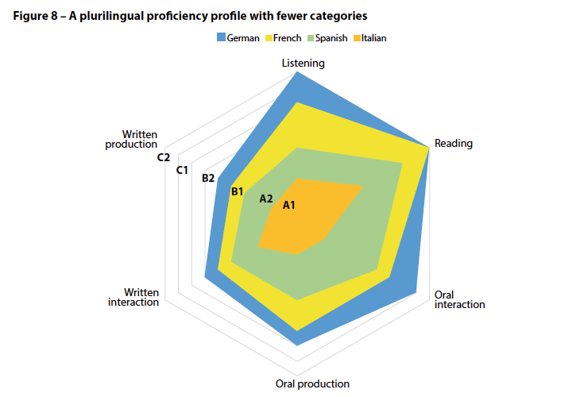
CEFR-CV, p. 40

Slide 11
So how do we respond to the twin challenges that Covid-19 poses?
At the level of policy
State or restate communicative curriculum goals in “can do” terms; summarize as a learner profile

Slide 12
So how do we respond to the twin challenges that Covid-19 poses?
At the level of policy
State or restate communicative curriculum goals in “can do” terms; summarize as a learner profile
Use checklists of “I can” descriptors to capture the learning trajectory of the curriculum and support detailed record-keeping by teachers

Slide 13
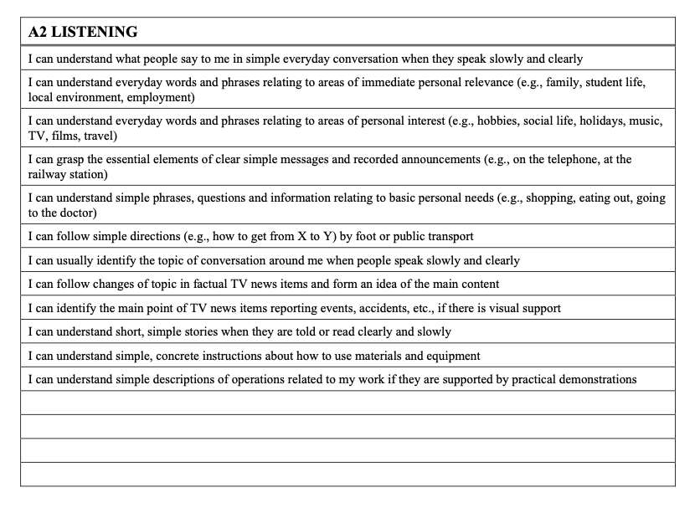

Slide 14
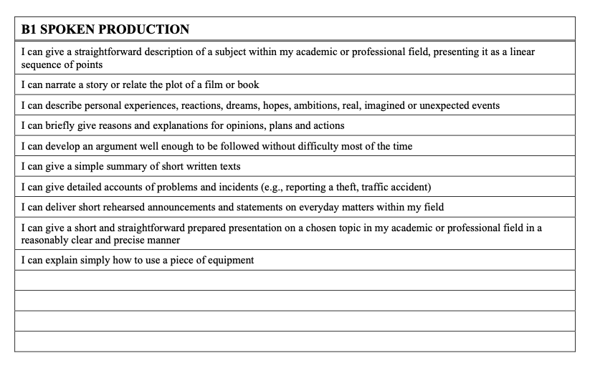

Slide 15
So how do we respond to the twin challenges that Covid-19 poses?
At the level of policy
State or restate communicative curriculum goals in “can do” terms; summarize as a learner profile
Use checklists of “I can” descriptors to capture the learning trajectory of the curriculum and support detailed record-keeping by teachers

Slide 16
So how do we respond to the twin challenges that Covid-19 poses?
At the level of policy
State or restate communicative curriculum goals in “can do” terms; summarize as a learner profile
Use checklists of “I can” descriptors to capture the learning trajectory of the curriculum and support detailed record-keeping by teachers
Specify the range of spoken and written texts learners are expected to work with at the various curriculum levels
Public exams
Ensure that the exams are an adequate measure of the learning trajectory described by the curriculum
Share rating criteria and scoring schemes with schools so that they can share them with students
At the level of practice
Introduce learners to checklists of “I can” descriptors
Engage teachers and learners in the development of tools – learning diaries, logbooks, portfolios – that help them manage their own learning
Adopt learning activities that are easy to relate to the checklist descriptors
Develop learners’ skills of self-assessment
Include alternative modes of assessment in awarding overall grades
Projects that display students’ skills in speaking, writing and interaction
Adapt rating criteria and scoring schemes from public exams
Establish networks of schools to moderate students’ course work

Slide 17
Over to you
Are these ideas worth exploring further?
If yes, how should we proceed?

